Slide 1
Logic Gates

Slide 2
Introduction
Digital systems are concerned with digital signals
Digital signals can take many forms
Here we will concentrate on binary signals since these are the most common form of digital signals
can be used individually
perhaps to represent a single binary quantity or the state of a single switch
can be used in combination
to represent more complex quantities

Slide 3
Boolean Constants and Variables
Boolean 0 and 1 do not represent actual numbers but instead represent the state, or logic level.
Logic 0
Logic 1
False
True
Off
On
Low
High
No
Yes
Open switch
Closed switch

Slide 4
Truth Tables
A truth table is a means for describing how a logic circuit output depends on the logic levels present at the circuit’s inputs.
Inputs
Output
A
B
x
0
0
1
A
0
1
0
?
x
1
0
1
B
1
1
0

Slide 5
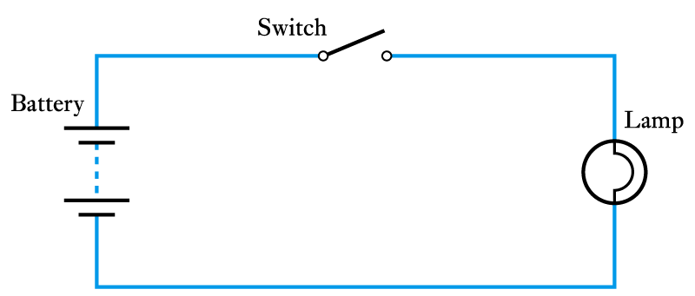
Binary Quantities and Variables
A binary quantity is one that can take only 2 states
S | L
OPEN | OFF
CLOSED | ON
S | L
0 | 0
1 | 1
A simple binary arrangement
A truth table

Slide 6
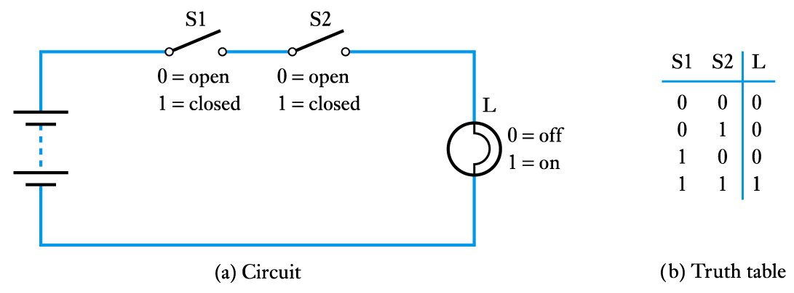
A binary arrangement with two switches in series
L = S1 AND S2

Slide 7
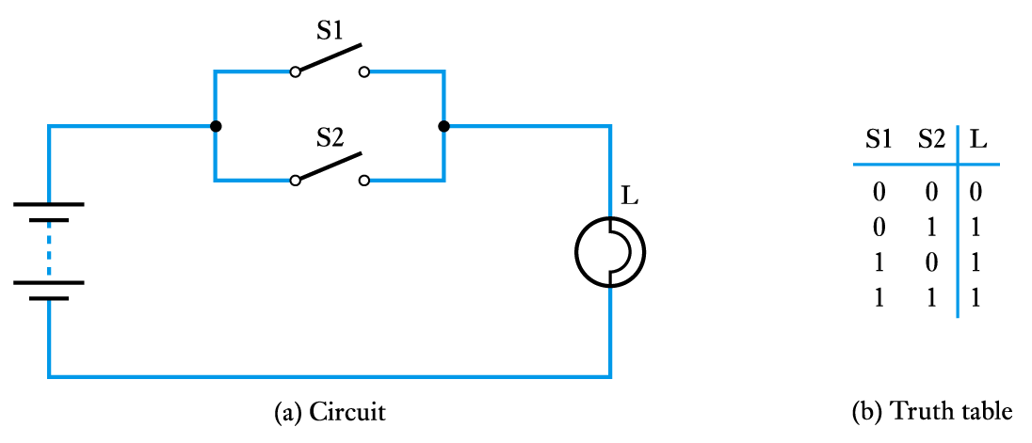
A binary arrangement with two switches in parallel
L = S1 OR S2

Slide 8
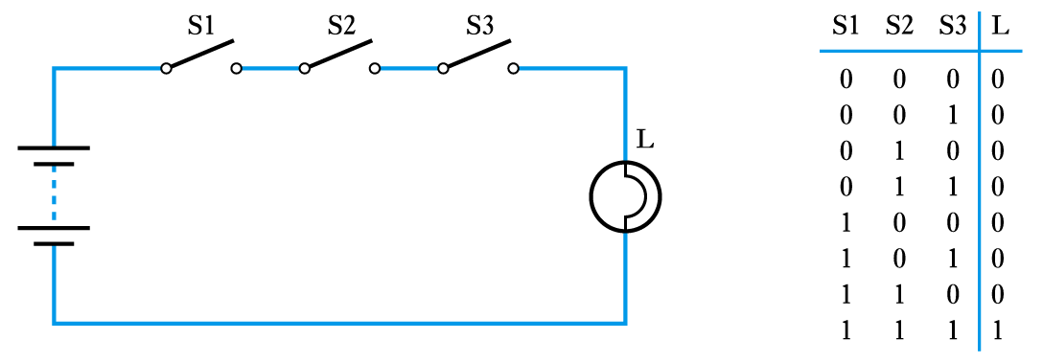
Three switches in series
L = S1 AND S2 AND S3

Slide 9
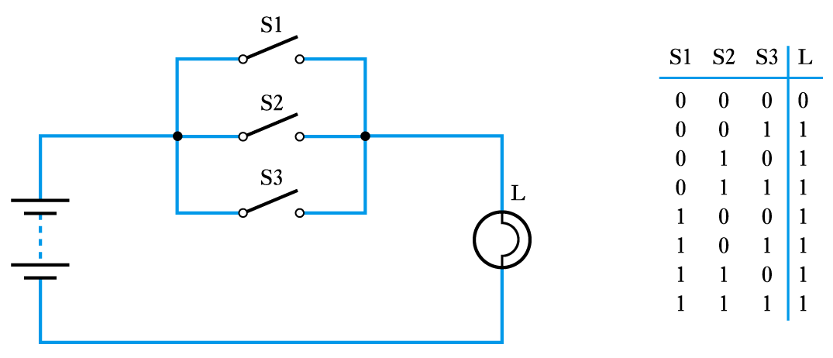
Three switches in parallel
L = S1 OR S2 OR S3

Slide 10
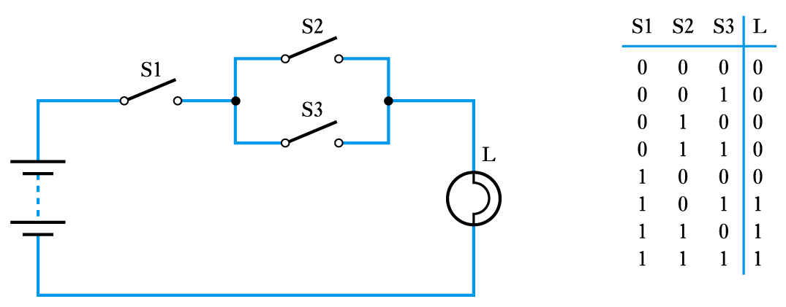
A series/parallel arrangement
L = S1 AND (S2 OR S3)

Slide 11
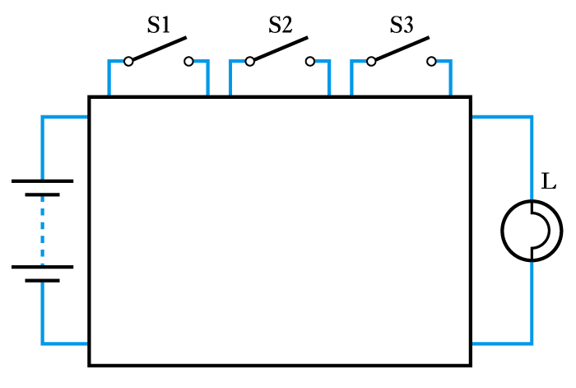
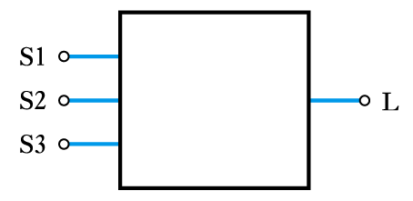
Representing an unknown network

Slide 12
Logic Gates
The building blocks used to create digital circuits are logic gates
There are three elementary logic gates and a range of other simple gates
Each gate has its own logic symbol which allows complex functions to be represented by a logic diagram
The function of each gate can be represented by a truth table or using Boolean notation

Slide 13
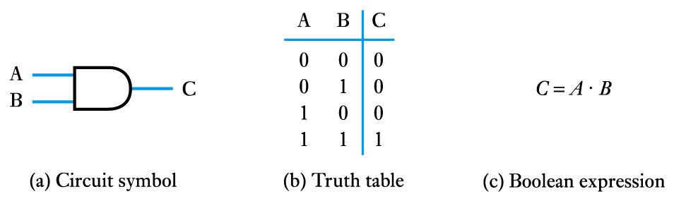
The AND gate

Slide 14
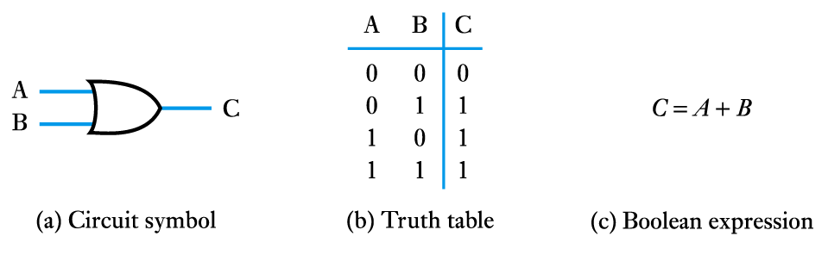
The OR gate

Slide 15
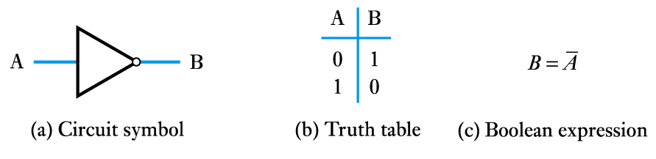
The NOT gate (or inverter)

Slide 16
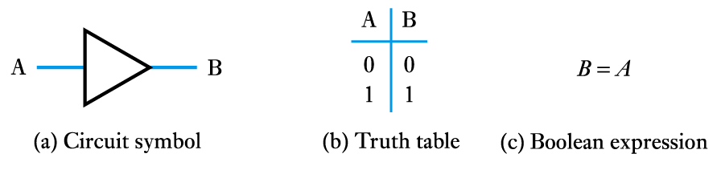
A logic buffer gate

Slide 17
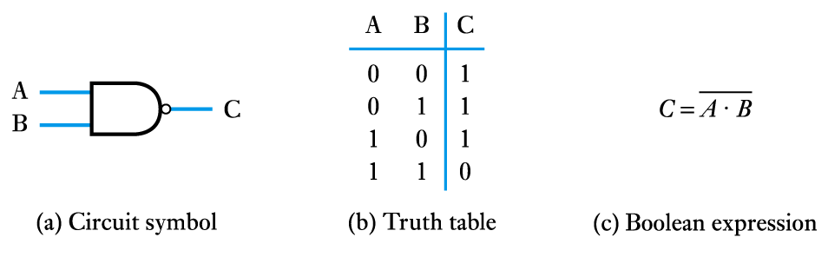
The NAND gate

Slide 18
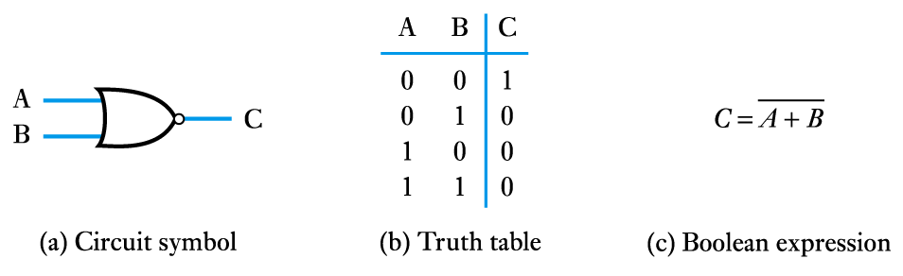
The NOR gate

Slide 19
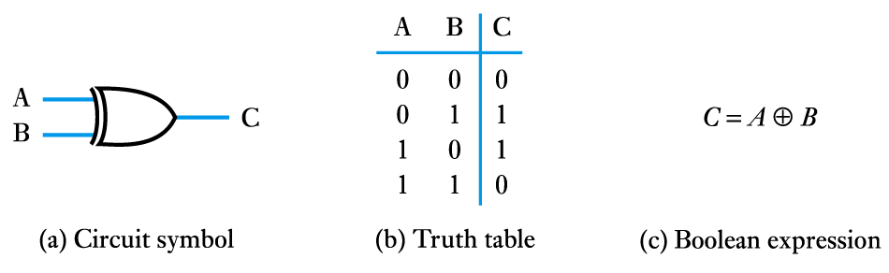
The Exclusive OR gate

Slide 20
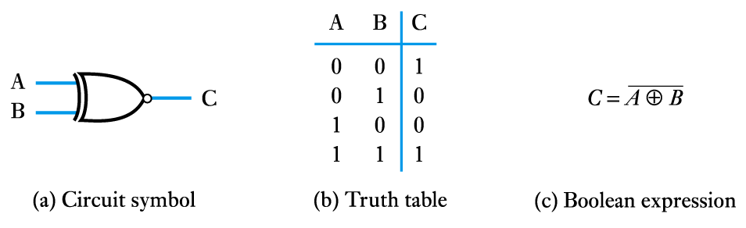
The Exclusive NOR gate

Slide 21
Boolean Algebra
Boolean Constants
these are ‘0’ (false) and ‘1’ (true)
Boolean Variables
variables that can only take the vales ‘0’ or ‘1’
Boolean Functions
each of the logic functions (such as AND, OR and NOT) are represented by symbols as described above
Boolean Theorems
a set of identities and laws – see text for details

Slide 22
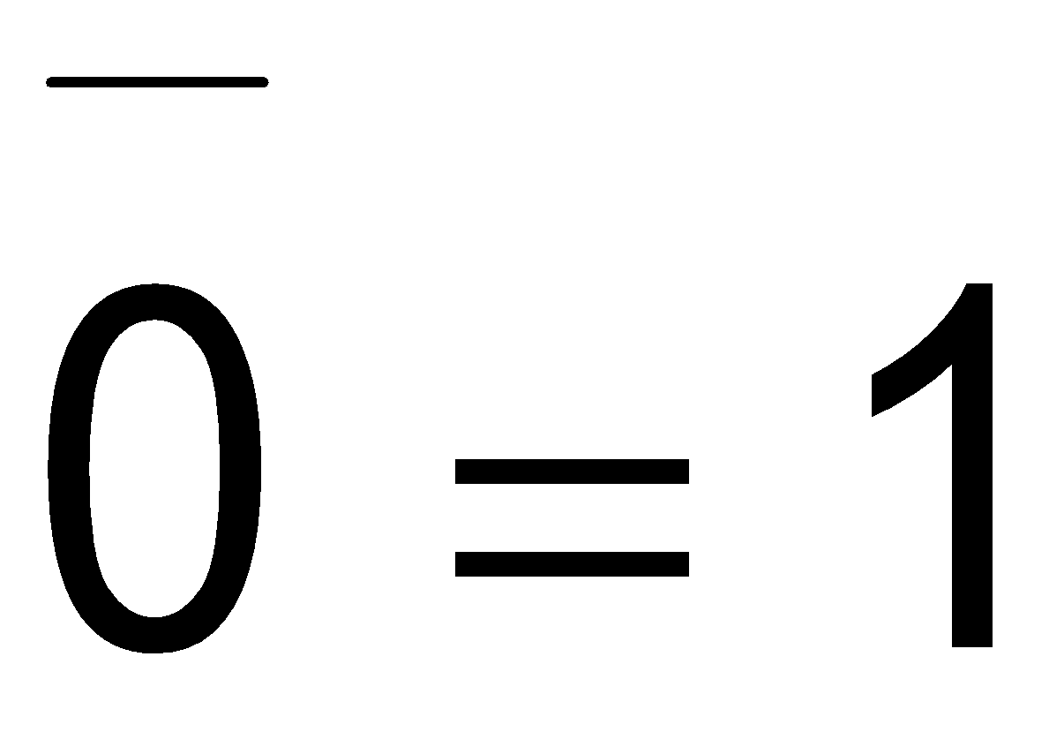
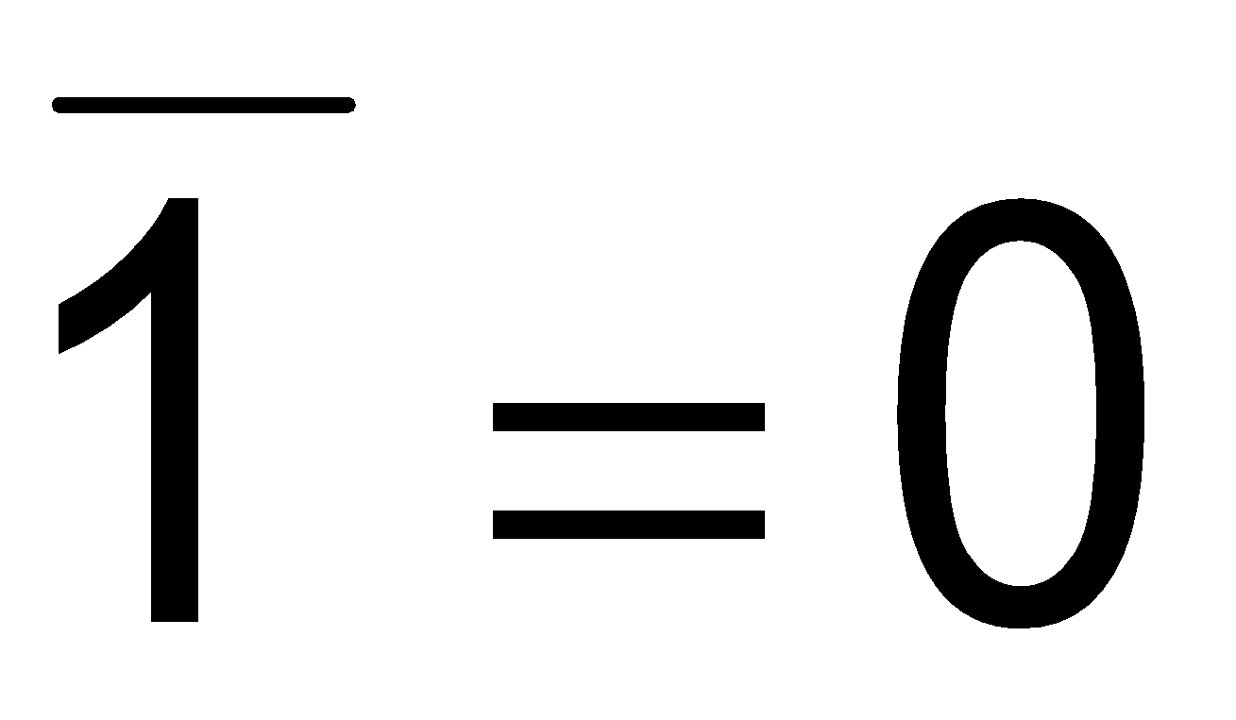
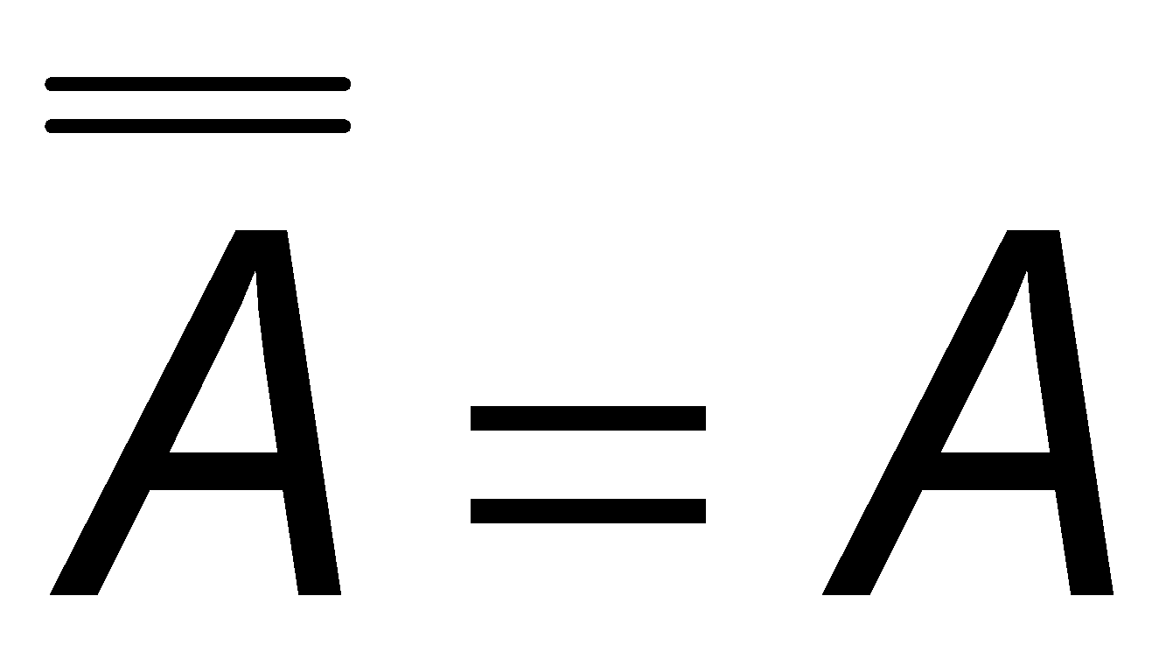
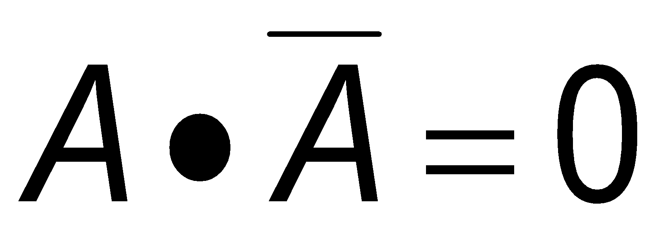
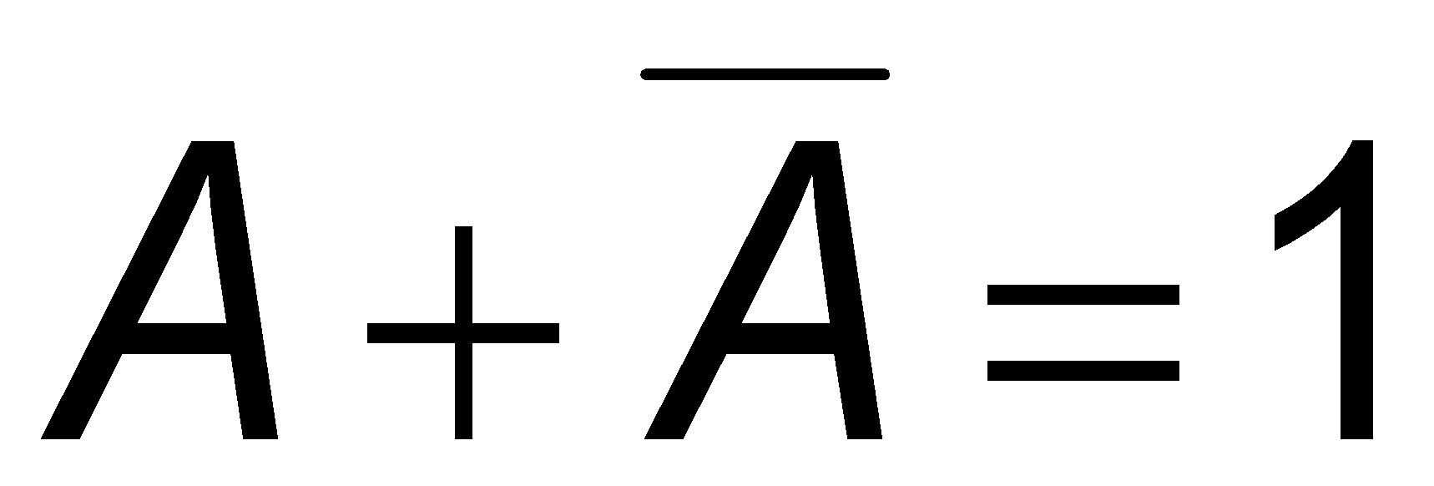
Boolean identities
AND Function | OR Function | NOT function
0∙0=0 | 0+0=0
0∙1=0 | 0+1=1
1∙0=0 | 1+0=1
1∙1=1 | 1+1=1
A∙0=0 | A+0=A
0∙A=0 | 0+A=A
A∙1=A | A+1=1
1∙A=A | 1+A=1
A∙A=A | A+A=A

Slide 23
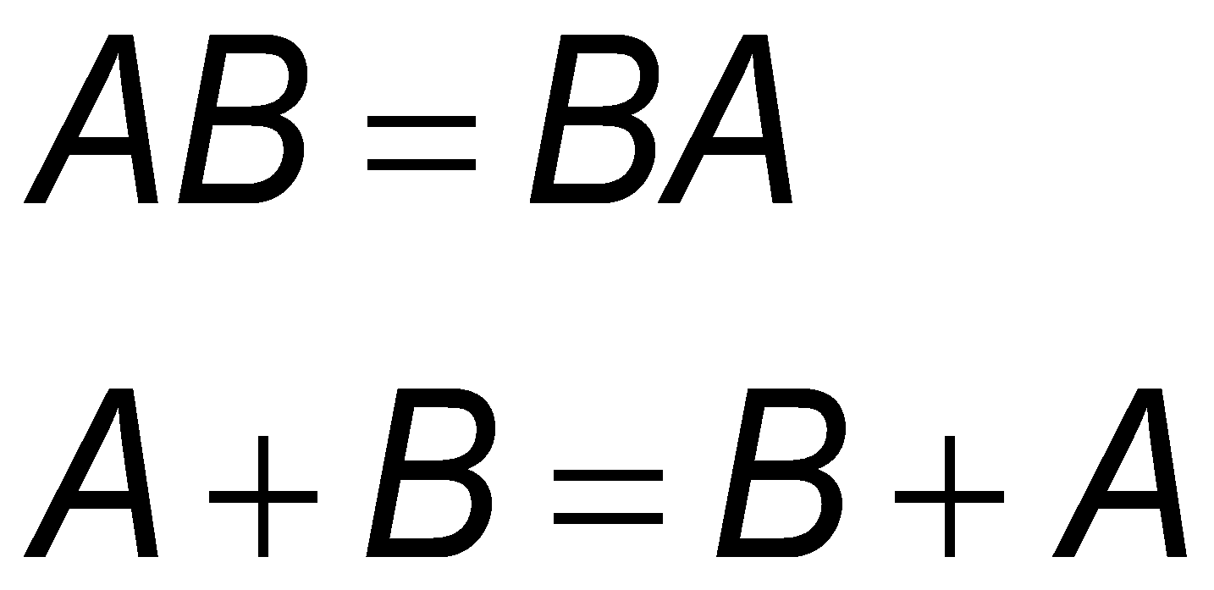
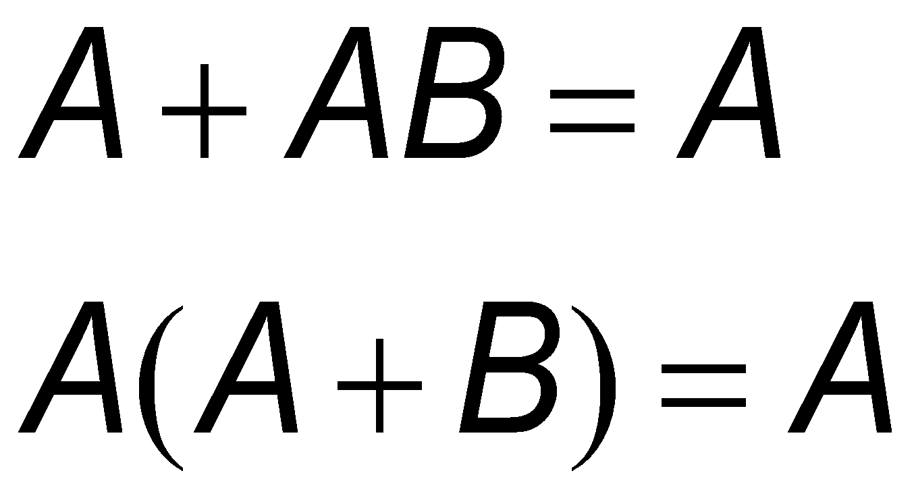
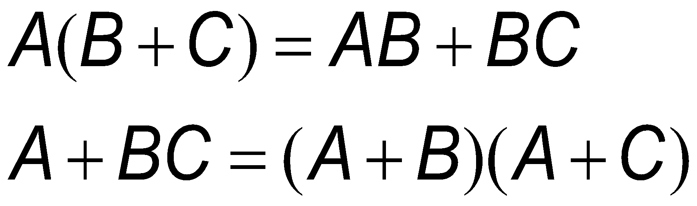
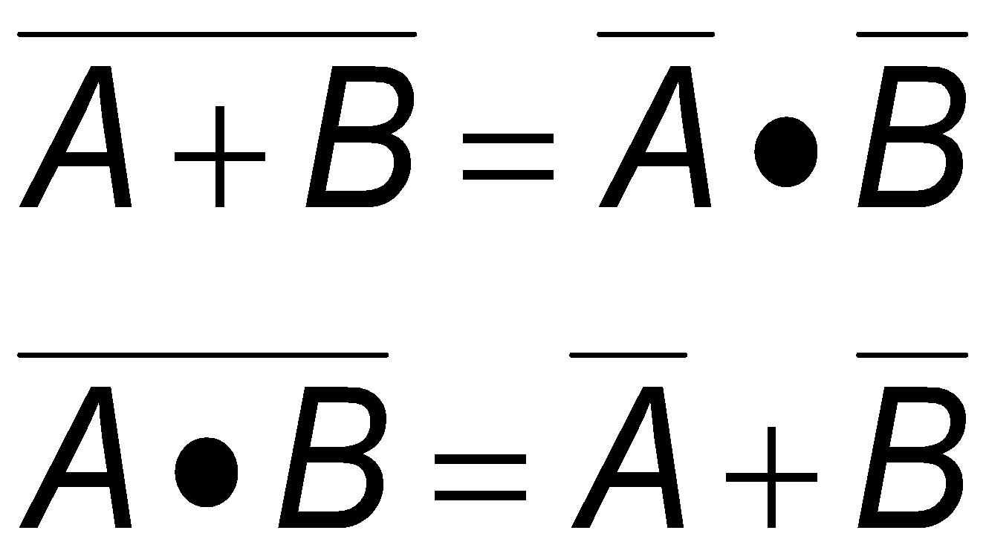
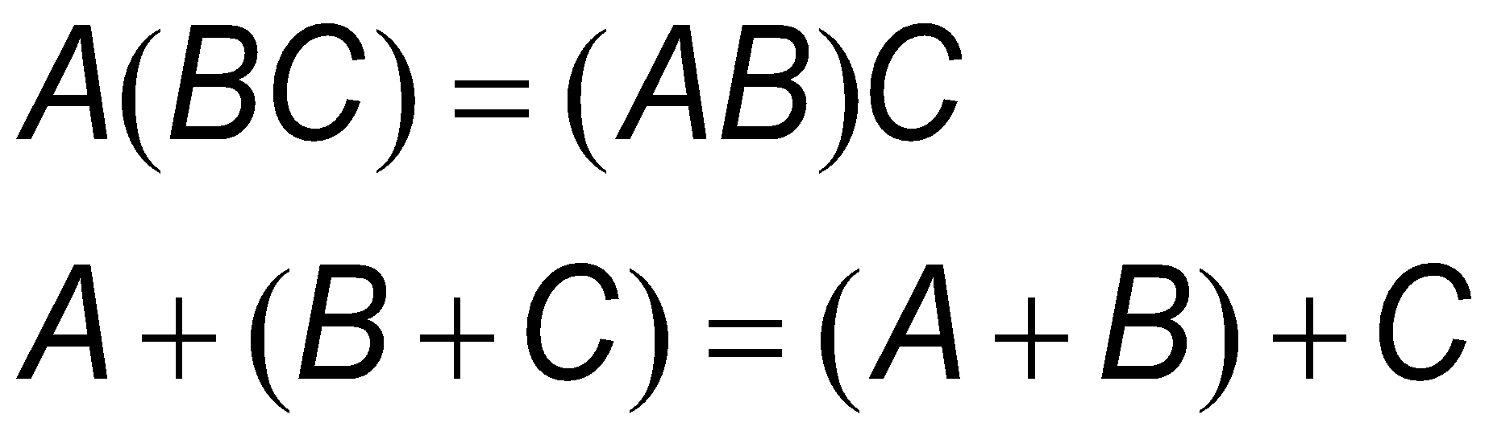
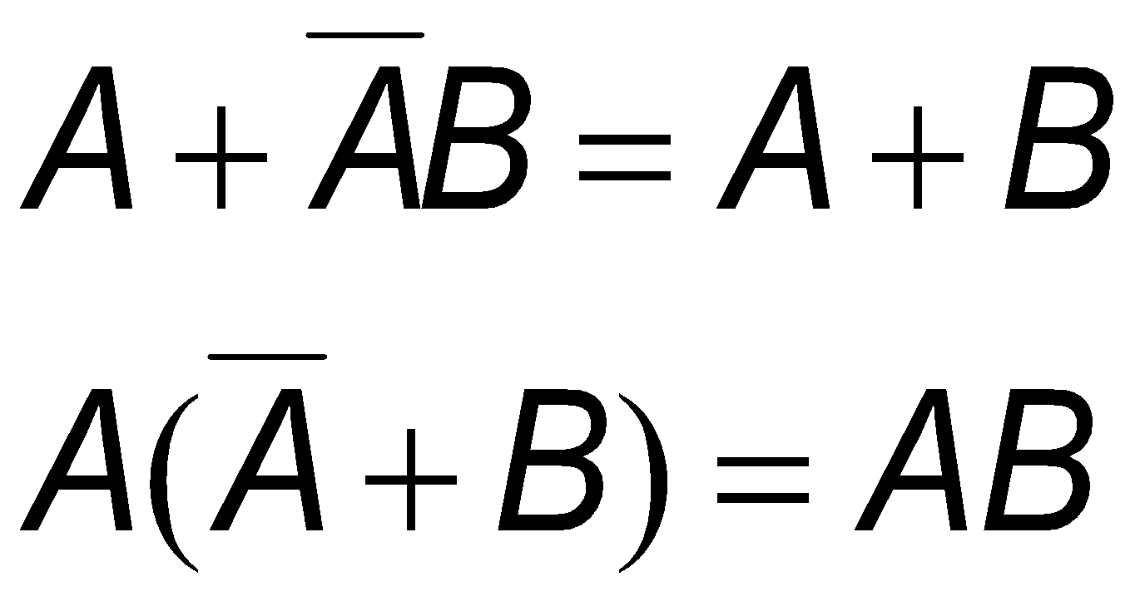
Boolean laws
Commutative law | Absorption law
Distributive law | De Morgan’s law
Associative law | Note also

Slide 24
Combinational Logic
Digital systems may be divided into two broad categories:
combinational logic
where the outputs are determined solely by the current states of the inputs
sequential logic
where the outputs are determined not only by the current inputs but also by the sequence of inputs that led to the current state
In this lecture we will look at combination logic

Slide 25
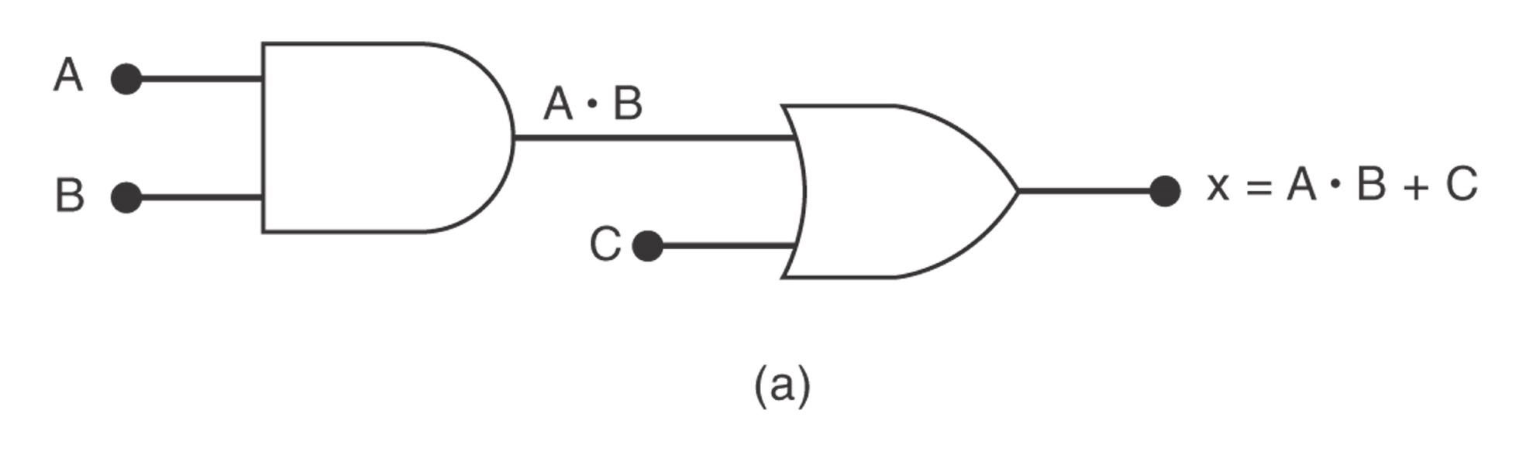
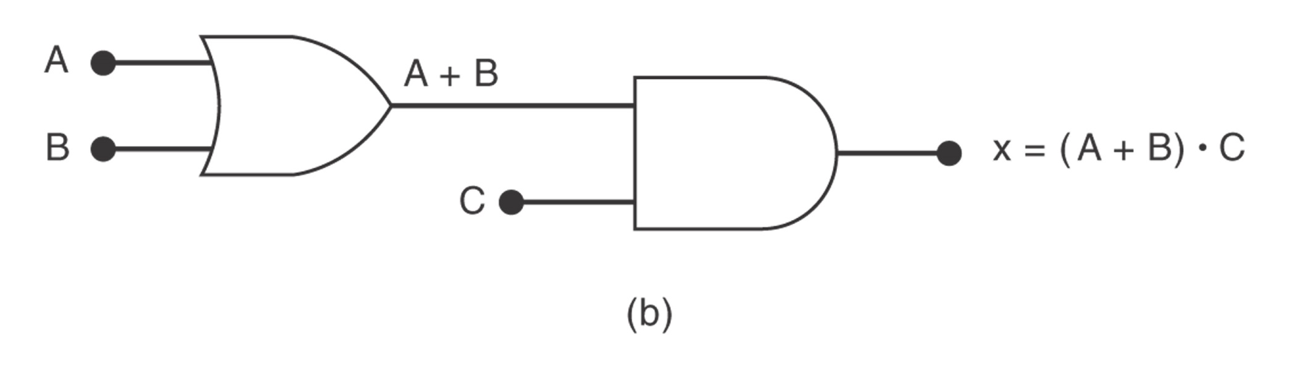
Examples 1,2

Slide 26
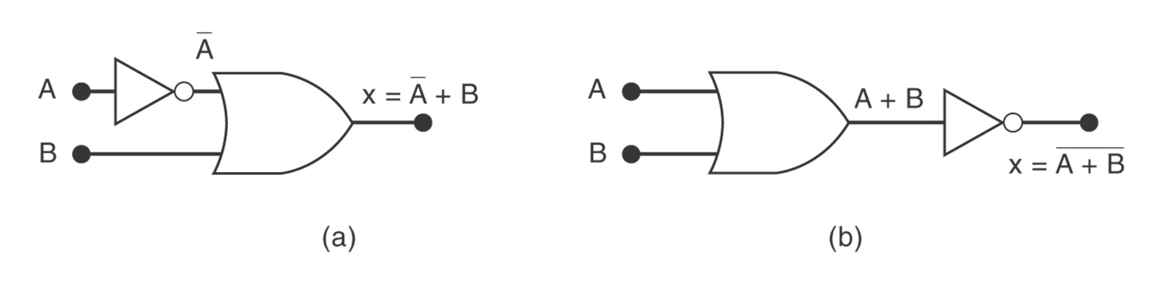
Examples 3

Slide 27
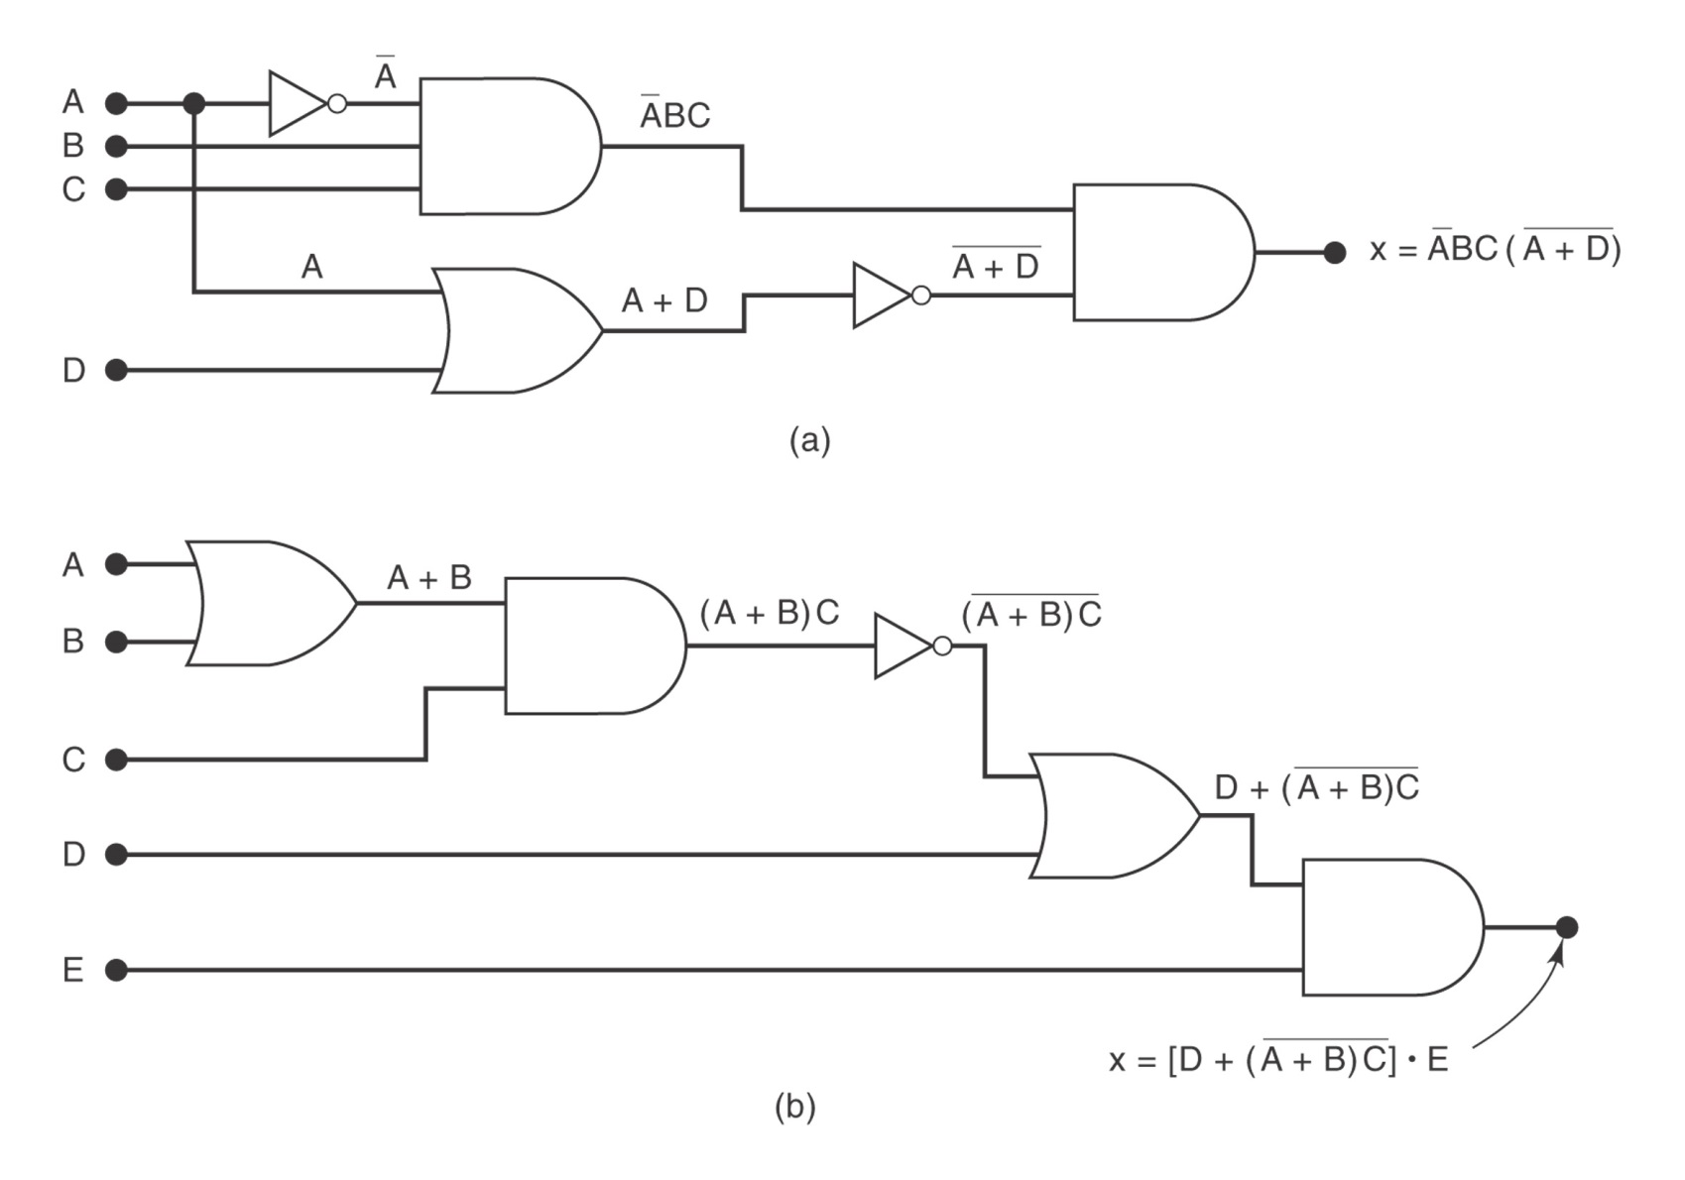
Example 4

Slide 28
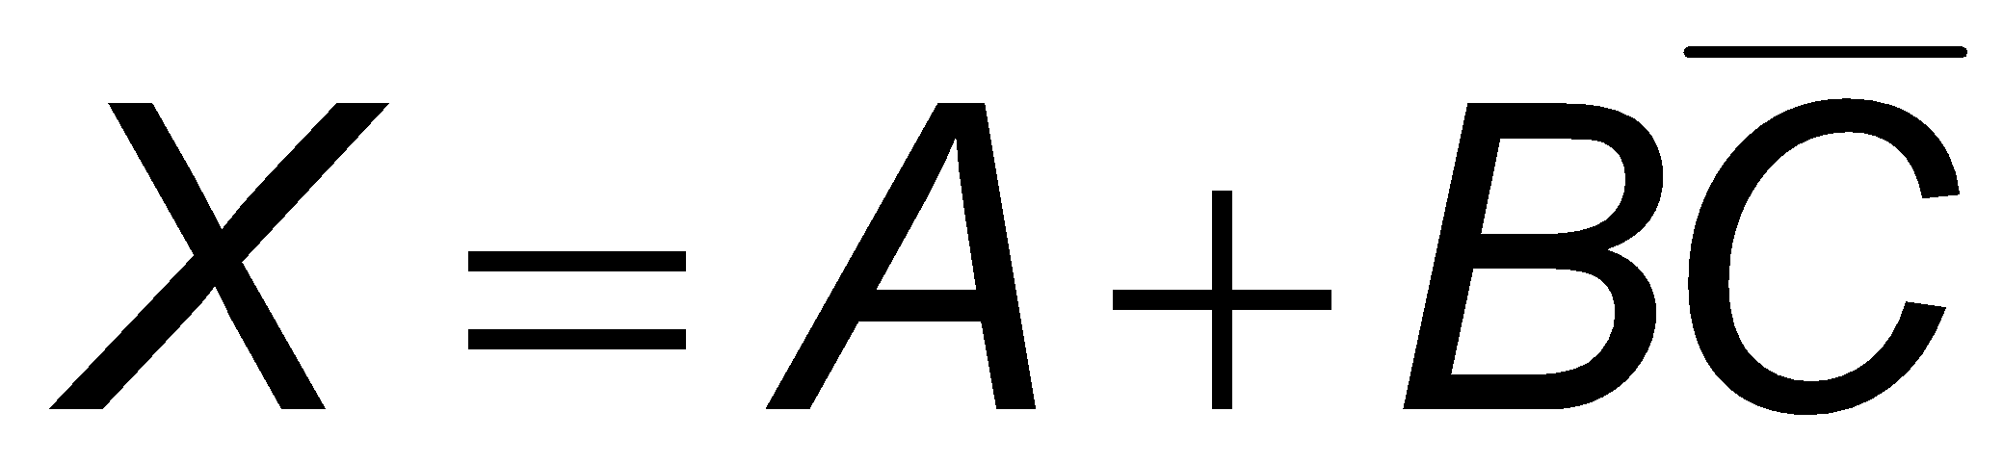
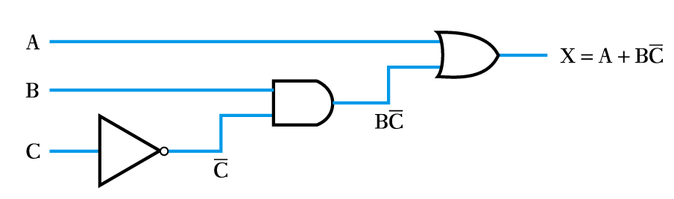
Implementing a function from a Boolean expression
Example –

Slide 29
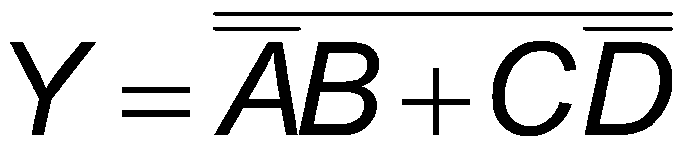
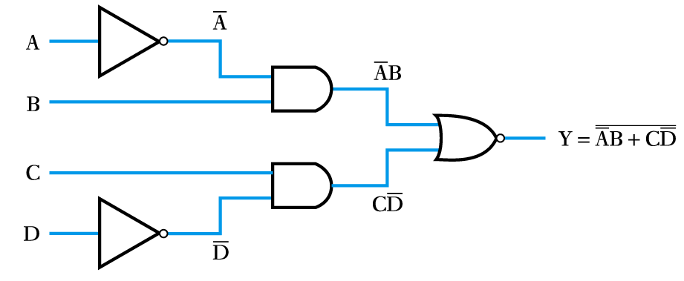
Implementing a function from a Boolean expression
Example –

Slide 30
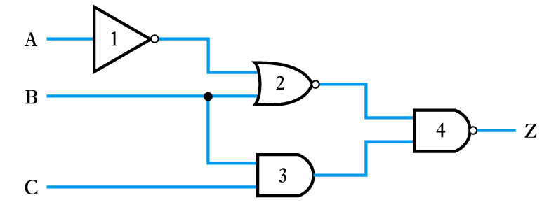
Generating a Boolean expression from a logic diagram
Example –

Slide 31
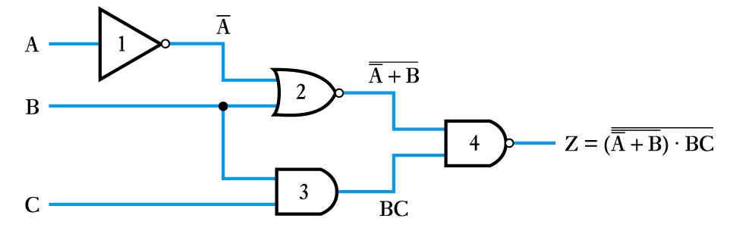
Example (continued)
– work progressively from the inputs to the output adding logic expressions to the output of each gate in turn

Slide 32
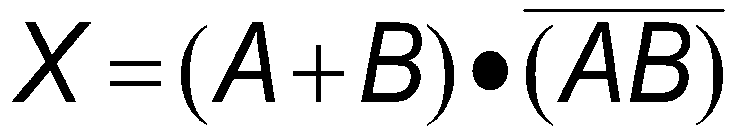
Implementing a logic function from a description
Example –
The operation of the Exclusive OR gate can be stated as:
“The output should be true if either of its inputs are true, but not if both inputs are true.”
This can be rephrased as:
“The output is true if A OR B is true, AND if A AND B are NOT true.”
We can write this in Boolean notation as

Slide 33
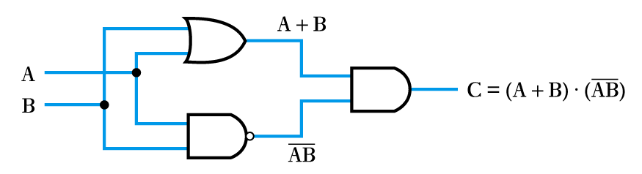
Example (continued)
The logic function
can then be implemented as before

Slide 34
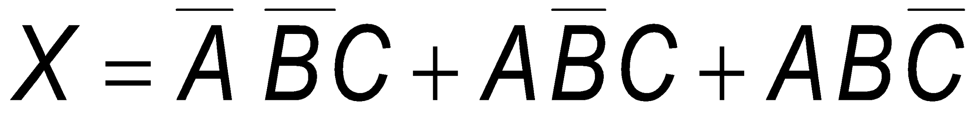
Implementing a logic function from a truth table
Example –
Implement the function of the following truth table
 | A | B | C | X
 | 0 | 0 | 0 | 0
 | 0 | 0 | 1 | 1
 | 0 | 1 | 0 | 0
 | 0 | 1 | 1 | 0
 | 1 | 0 | 0 | 0
 | 1 | 0 | 1 | 1
 | 1 | 1 | 0 | 1
 | 1 | 1 | 1 | 0
first write down a Boolean expression for the output
then implement as before
in this case

Slide 35
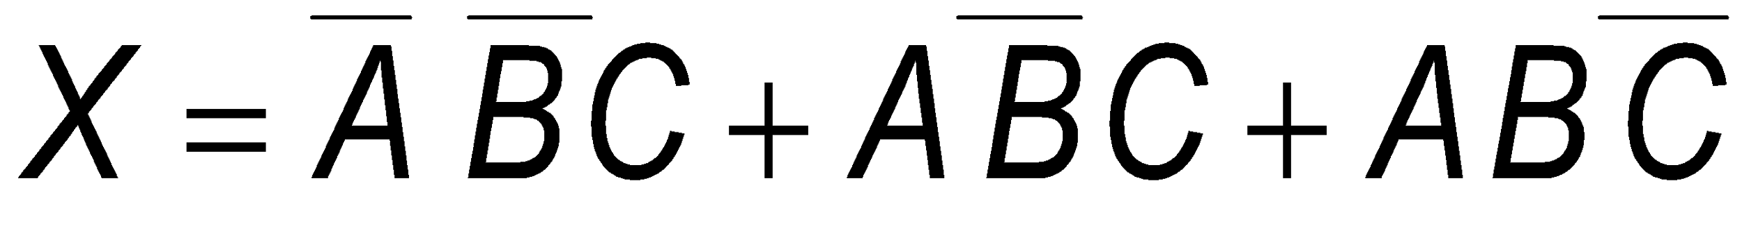
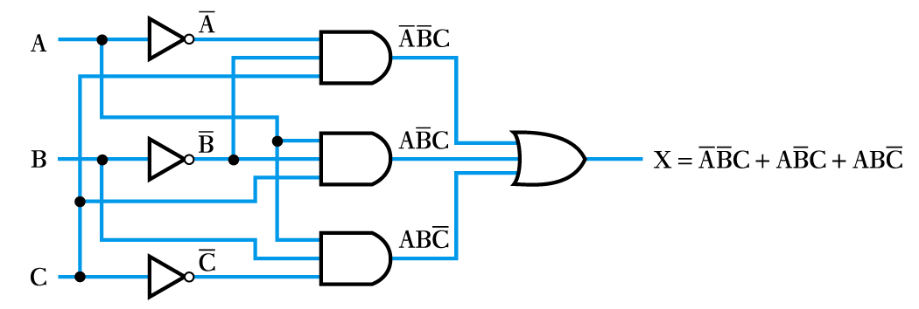
Example (continued)
The logic function
can then be implemented as before

Slide 36
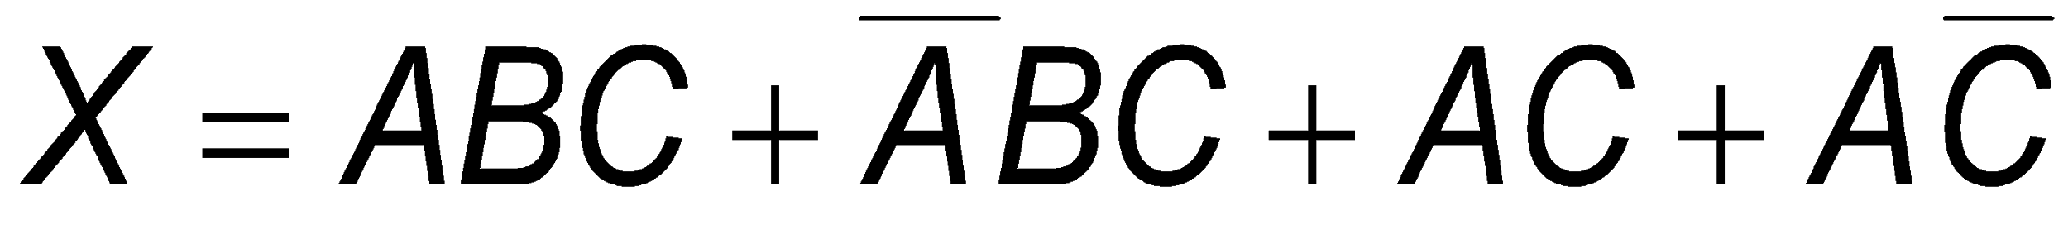
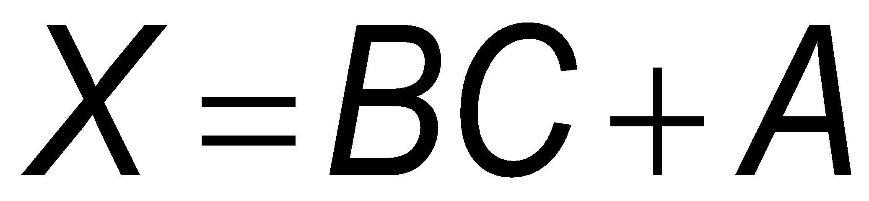
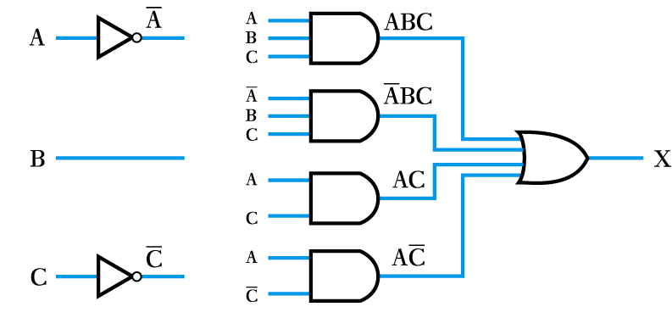
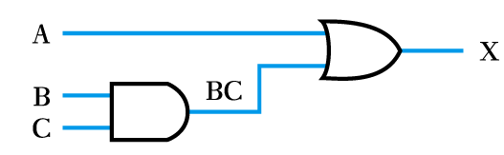
In some cases it is possible to simplify logic expressions using the rules of Boolean algebra
Example –
can be simplified to
hence the following circuits are equivalent

Slide 37
Number Systems and Binary Arithmetic
Most number systems are order dependent
Decimal
1234₁₀ = (1 × 10³) + (2 × 10²) + (3 × 10¹) + (4 × 10⁰)
Binary
1101₂ = (1 × 2³) + (1 × 2²) + (0 × 2¹) + (1 × 2⁰)
Octal
123₈ = (1 × 8³) + (2 × 8²) + (3 × 8¹)
Hexadecimal
123₁₆ = (1 × 16³) + (2 × 16²) + (3 × 16¹)
here we need 16 characters – 0,1,2,3,4,5,6,7,8,9,A,B,C,D,E,F

Slide 38
Number conversion
conversion to decimal
add up decimal equivalent of individual digits
Example – see Example 9.8 in the course text
Convert 11010₂ to decimal
110102 = (1 × 2⁴) + (1 × 2³) + (0 × 2²) + (1 × 2¹) + (0 × 2⁰)
= 16 + 8 + 0 + 2 + 0
= 2610

Slide 39
Number conversion
conversion from decimal
repeatedly divide by the base and remember the remainder
Example – see Example 9.9 in the course text
Convert 26₁₀ to binary
Number Remainder
Starting point 26
÷ 2 13 0
÷ 2 6 1
÷ 2 3 0
÷ 2 1 1
÷ 2 0 1
read number from this end
=11010

Slide 40
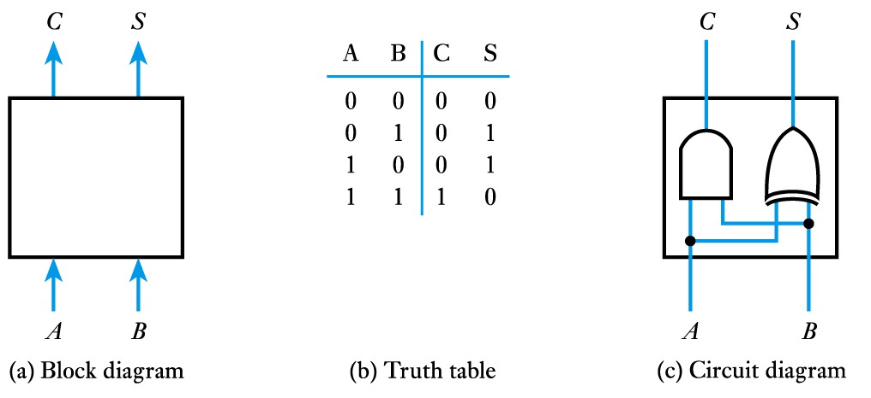
Binary arithmetic
much simpler than decimal arithmetic
can be performed by simple circuits, e.g. half adder

Slide 41
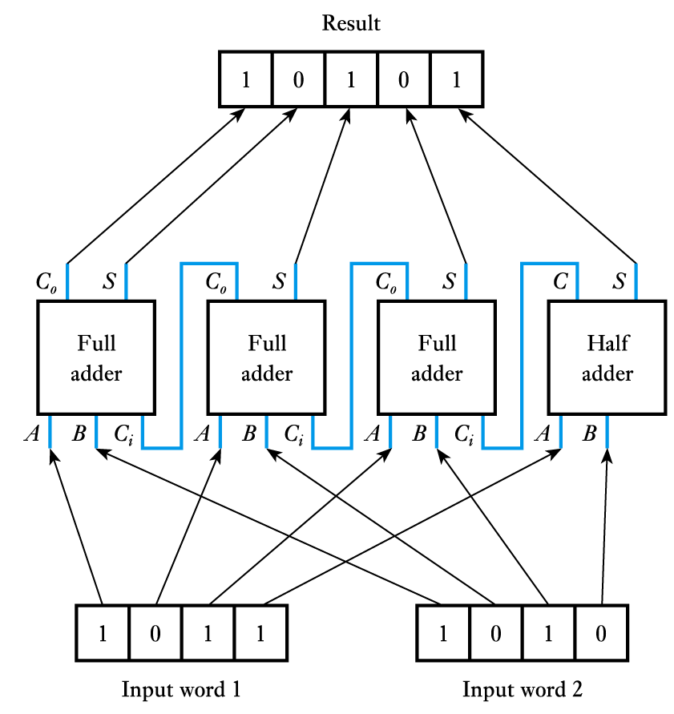
More complex circuits can add digital words
Similar circuits can be constructed to perform subtraction – see text
More complex arithmetic (such as multiplication and division) can be done by dedicated hardware but is more often performed using a microcomputer or complex logic device

Slide 42
Numeric and Alphabetic Codes
Binary code
by far the most common way of representing numeric information
has advantages of simplicity and efficiency of storage
Decimal
Binary
0
1
2
3
4
5
6
7
8
9
10
11
12
etc.
0 1 10 11 100 101
110
111
1000
1001
1010
1011
1100
etc.

Slide 43
Numeric and Alphabetic Codes
Binary-coded decimal code
formed by converting each digit of a decimal number individually into binary
requires more digits than conventional binary
has advantage of very easy conversion to/from decimal
used where input and output are in decimal form
Decimal
Binary
0
1
2
3
4
5
6
7
8
9
10
11
12
etc.
0 1 10 11 100 101
110
111
1000
1001
10000
10001
10010
etc.

Slide 44
Numeric and Alphabetic Codes
ASCII code
American Standard Code for Information Interchange
an alphanumeric code
each character represented by a 7-bit code
gives 128 possible characters
codes defined for upper and lower-case alphabetic characters, digits 0 – 9, punctuation marks and various non-printing control characters (such as carriage-return and backspace)

Slide 45
Numeric and Alphabetic Codes
Error detecting and correcting codes
adding redundant information into codes allows the detection of transmission errors
examples include the use of parity bits and checksums
adding additional redundancy allows errors to be not only detected but also corrected
such techniques are used in CDs, mobile phones and computer disks

Slide 46
Key Points
It is common to represent the two states of a binary variable by ‘0’ and ‘1’
Logic circuits are usually implemented using logic gates
Circuits in which the output is determined solely by the current inputs are termed combinational logic circuits
Logic functions can be described by truth tables or using Boolean algebraic notation
Binary digits may be combined to form digital words
Digital words can be processed using binary arithmetic
Several codes can be used to represent different forms of information

